Slide 1


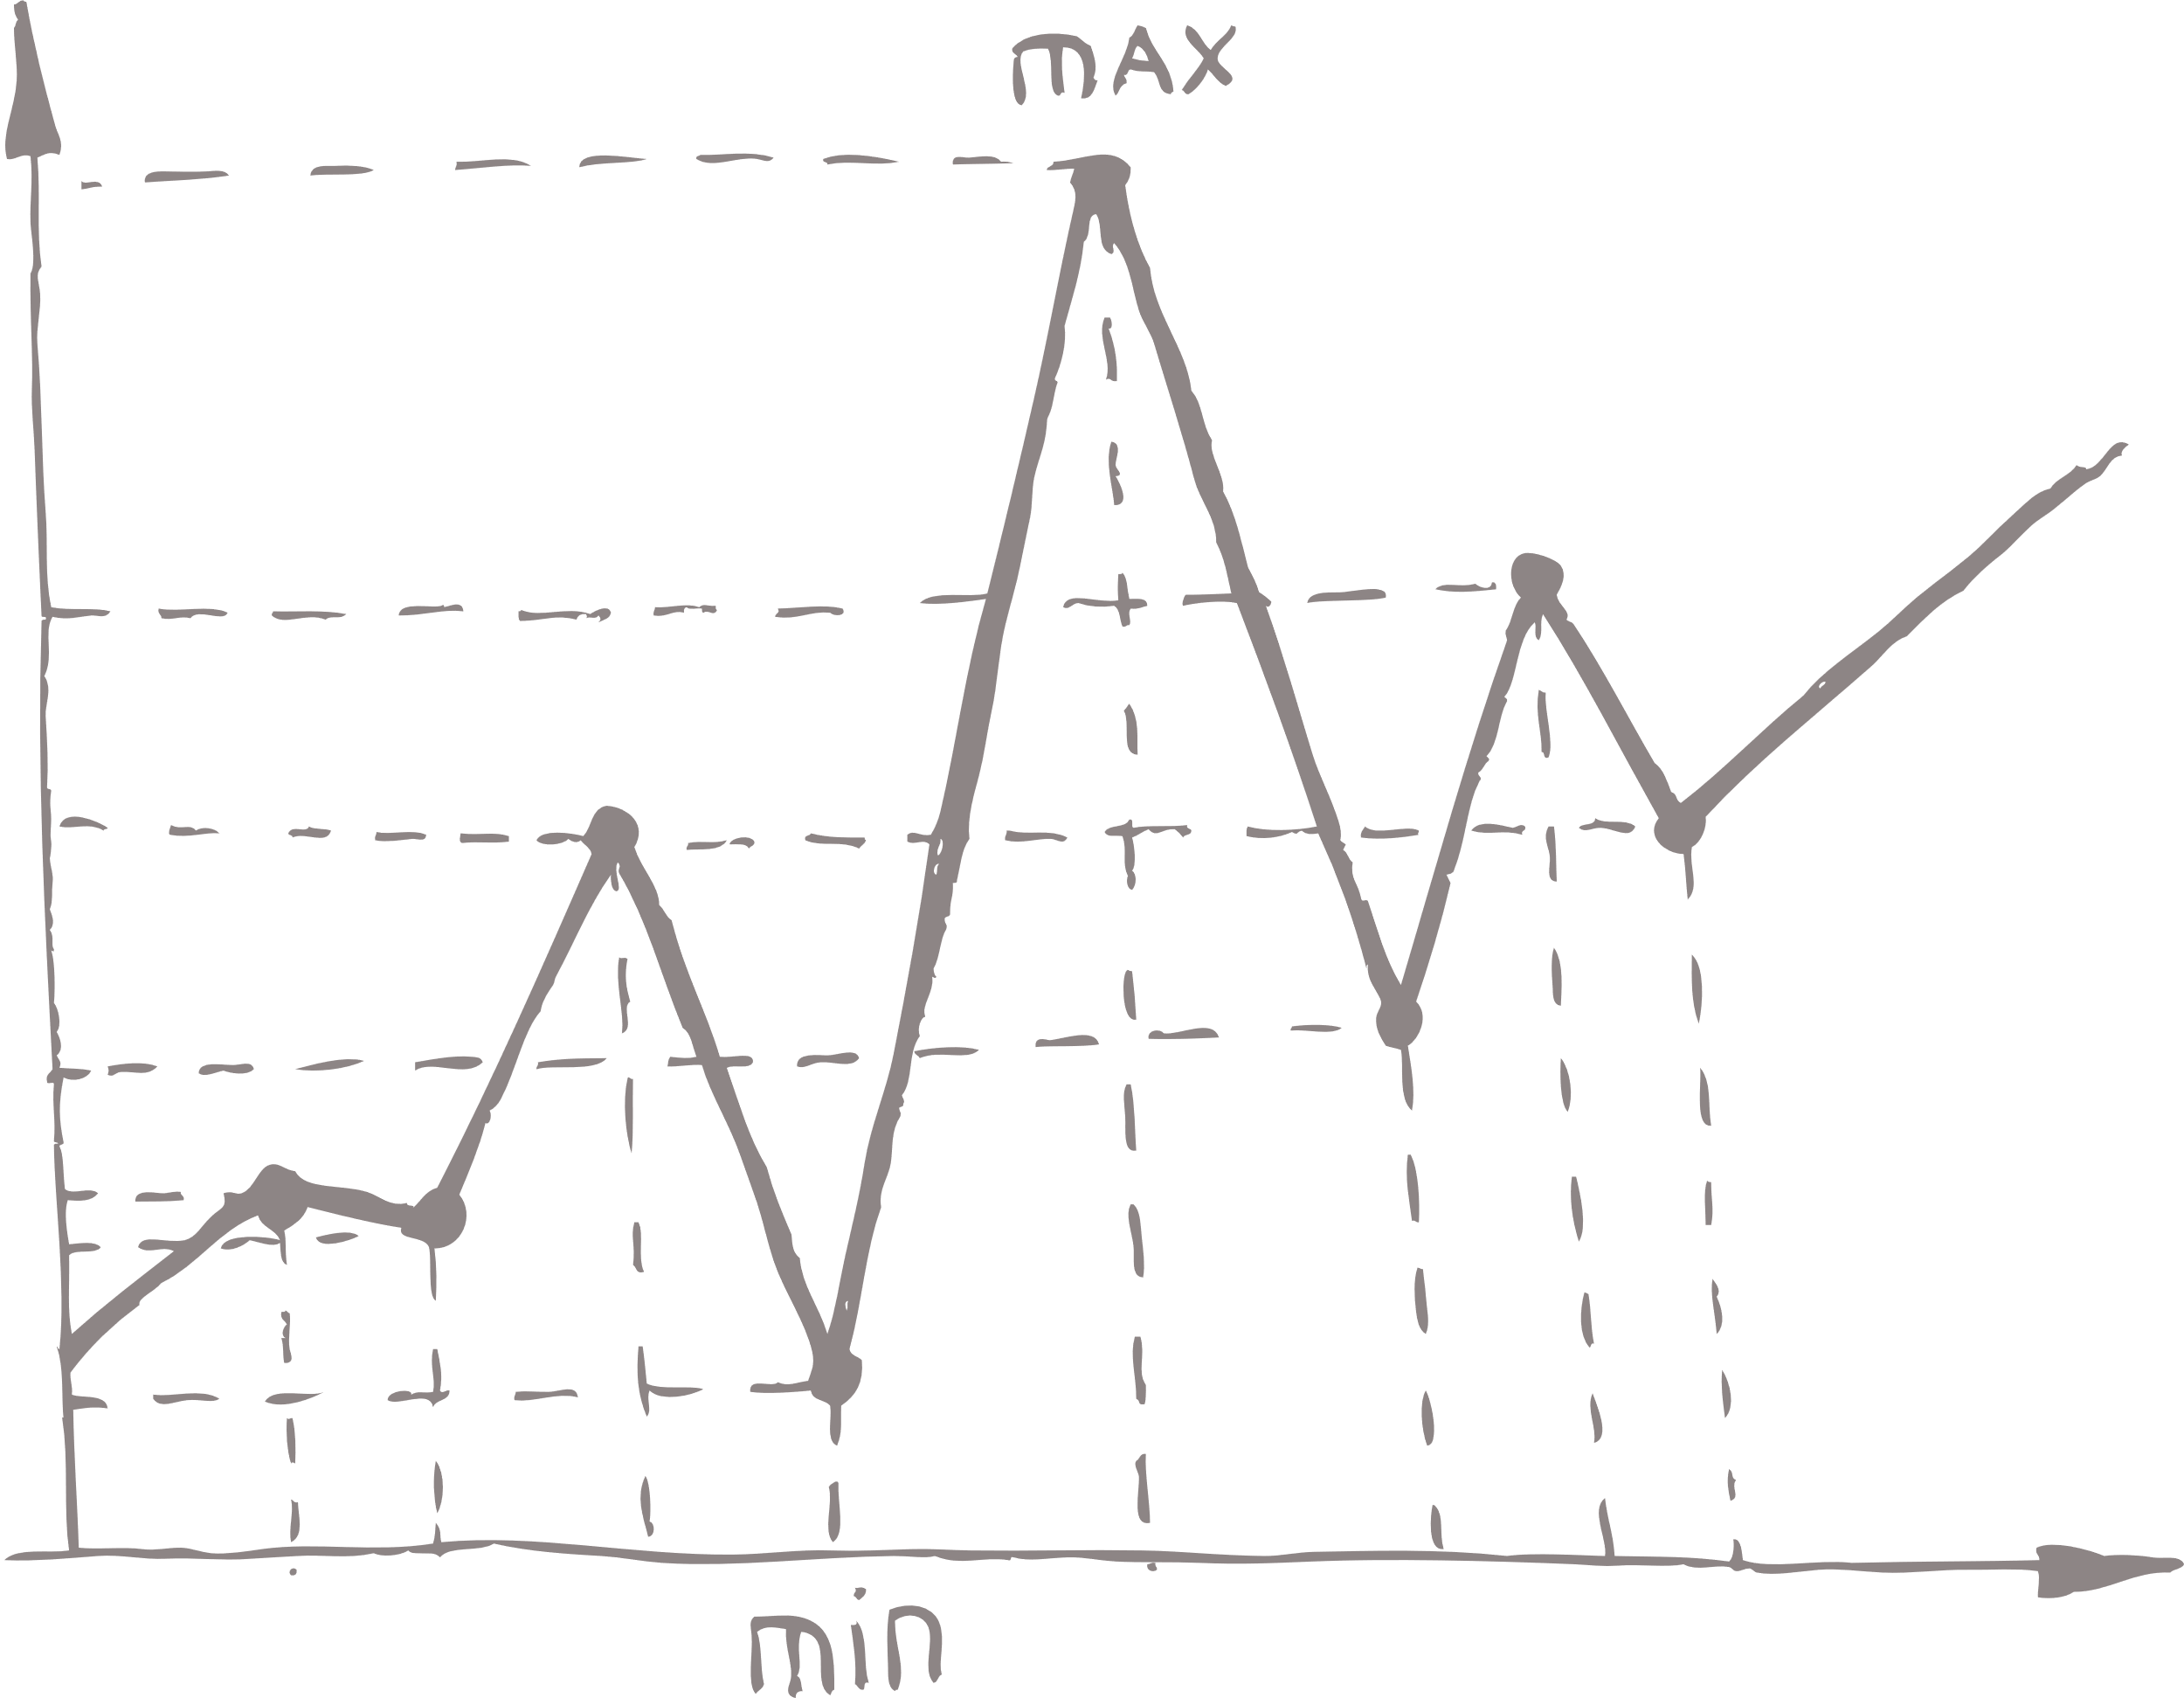



SQL
Project
Presented by NIKHIL PATIL
BATCH – DS (15th NOVEMBER)

Slide 2
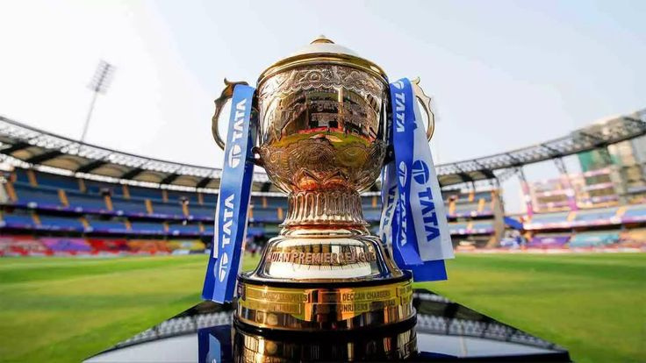

POSTGRE-SQL PROJECT
ON
INDIAN PREMIER
LEAGUE
~INTERNSHALA~

Slide 3
Project Introduction
We are developing an auction strategy for the new IPL franchise by analyzing past IPL data to create a strong and balanced squad.
To develop the strategy the objective is divided into small objectives to create a balanced squad.
1. Aggressive Batsman.
2. Anchor Batsman.
3. Hard Hitter Batsman.
4. Bowlers with Good Economy.
5. Best Strike Rate Bowlers
6. All Rounders
7. Wicketkeeper.
Aim of the project

Slide 4
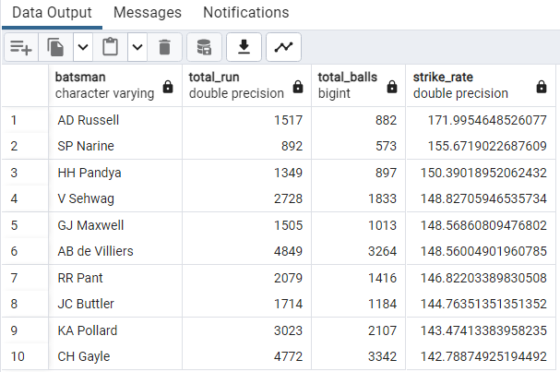
OBJECTIVE I –
Your first priority is to get 2-3 players with high STRIKE RATE who have faced at least 500 balls.And to do that you have to make a list of 10 players you want to bid in the auction
select batsman,
SUM(batsman_runs) AS Total_run,
COUNT(ball) AS Total_balls,
(sum(batsman_runs) / count(ball)) * 100 AS Strike_Rate
from ipl_ball
group by batsman HAVING COUNT(ball) >= 500
ORDER BY Strike_Rate DESC
LIMIT 10;

Slide 5
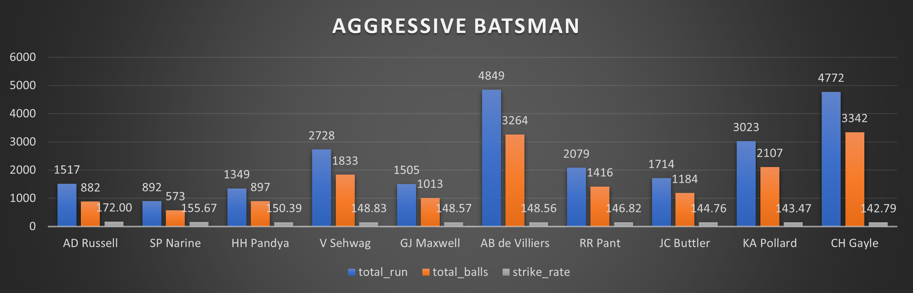

Slide 6
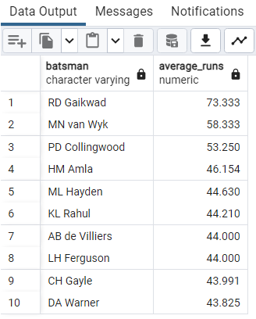
OBJECTIVE II –
We need to get 2 to 3 players with good averages who have played more than 2 IPL seasons. And to do that you have to make a list of 10 players you want to bid in the auction.
WITH batsman_season AS (
SELECT
b.batsman,
SUBSTRING (date, 7,8) AS match_year,
COUNT(*) AS match_count,
SUM(b.is_wicket) AS wicket_count,
SUM(b.total_runs) AS total_runs
FROM ipl_ball b
INNER JOIN ipl_matches m ON b.id = m.id
GROUP BY b.batsman,
match_year
HAVING COUNT(*) >= 2
)
SELECT batsman,
round(SUM(total_runs)/NULLIF(SUM(wicket_count), 0), 3) AS average_runs
FROM batsman_season
WHERE
wicket_count > 0
GROUP BY
batsman
ORDER BY
average_runs DESC
LIMIT 10;

Slide 7
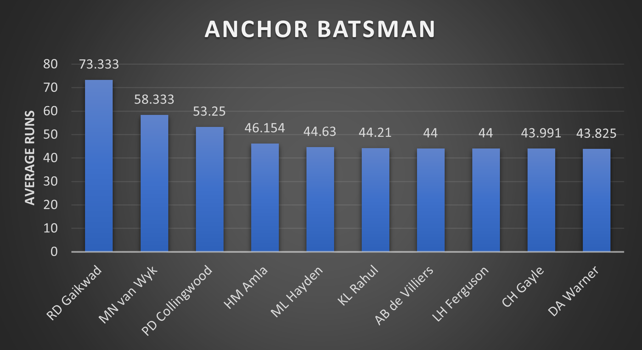

Slide 8
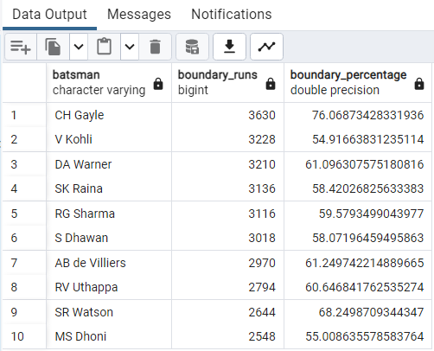
OBJECTIVE III –
We need to get 2 to 3 Hard-hitting players who have scored the most runs in boundaries and have played more in the 2 ipl season. To do that you have to make a list of 10 players you want to bid in the auction.
select batsman,
sum(case when batsman_runs = 4 then 4
when batsman_runs = 6 then 6 else 0 end) as boundary_runs,
sum(case when batsman_runs = 4 then 4
when batsman_runs = 6 then 6 else 0 end)*100/sum(batsman_runs) as boundary_percentage
from ipl_ball
where batsman in (
select b.batsman
from ipl_ball b
inner join ipl_matches m
on b.id = m.id
group by b.batsman
having count(distinct(substring (date, 7,8))) > 1
)
and batsman_runs <> 0
group by batsman
order by boundary_runs desc, boundary_percentage desc
limit 10 ;

Slide 9
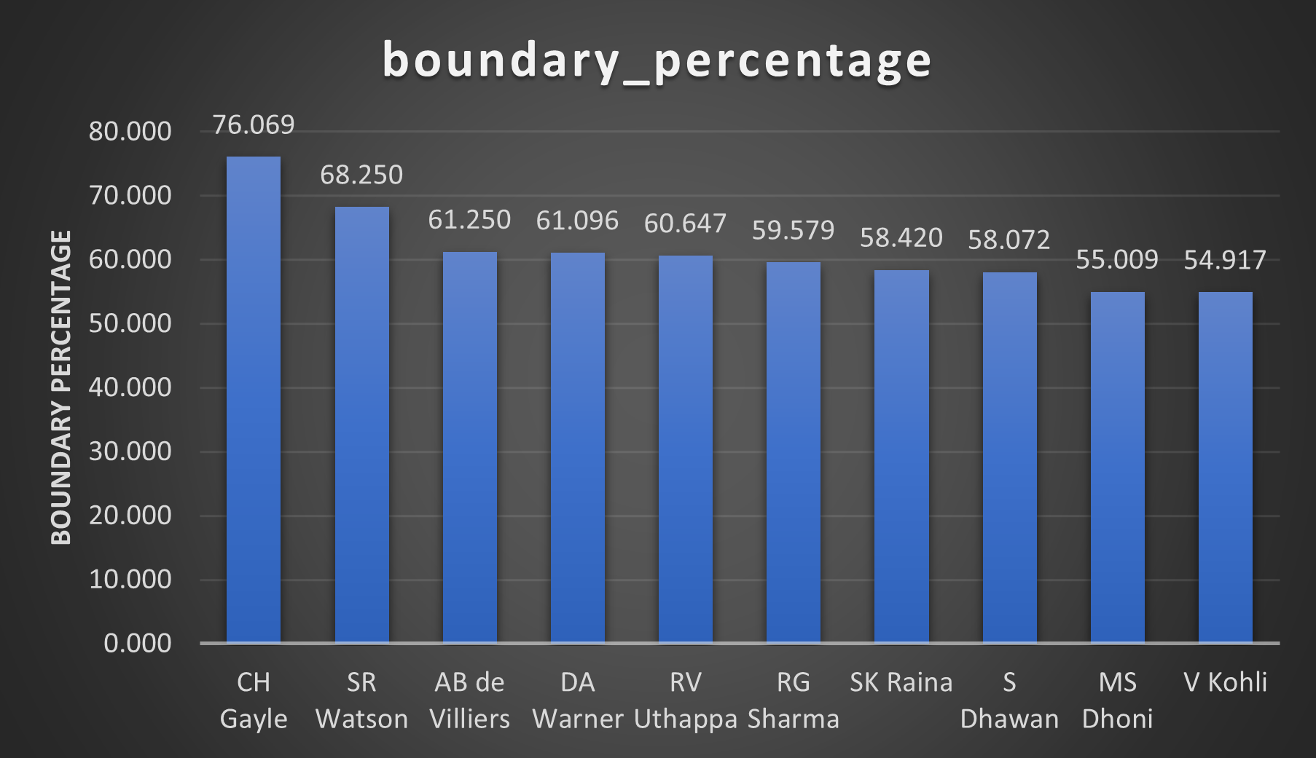

Slide 10
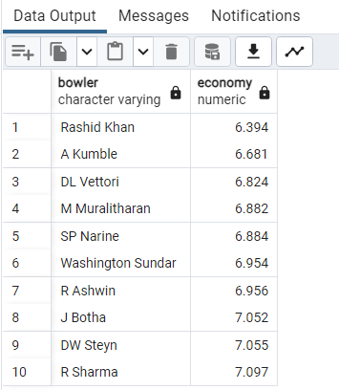
OBJECTIVE IV –
Your priority is to get 2-3 bowlers with good economy who have bowled at least 500 balls in the IPL so far. To do that you have to make a list of 10 players you want to bid in the auction.
Select bowler,
round(sum(match_runs) / sum(match_overs),3) as economy
from (
select bowler,
m.date,
sum(total_runs) as match_runs,
count(distinct over) as match_overs,
count(*) as match_balls
From ipl_ball b
inner join
ipl_matches m on b.id = m.id
group by bowler, m.date
)
as match_stats
group by bowler having sum(match_balls) >= 500
order by economy
limit 10;

Slide 11
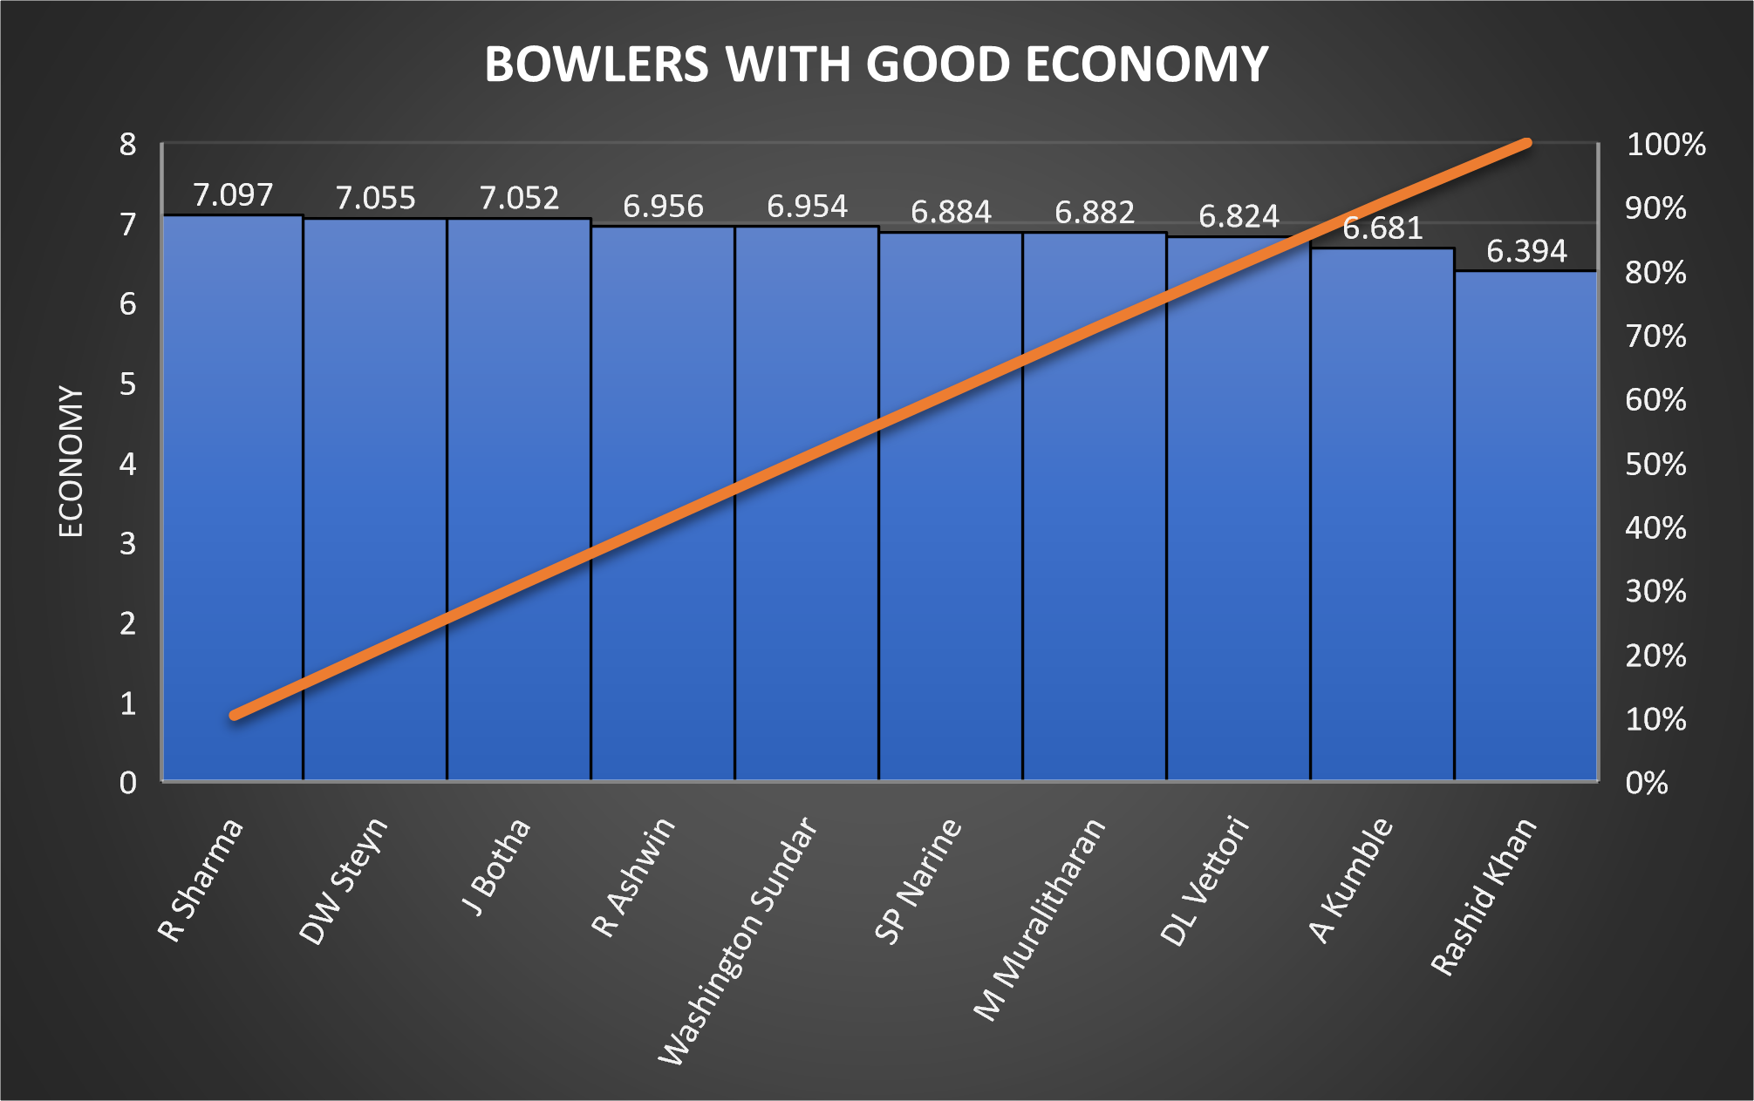

Slide 12
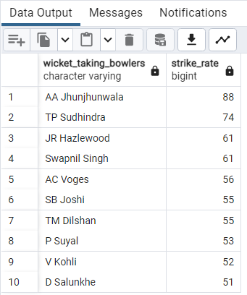
OBJECTIVE V –
Now we need to get 2-3 bowlers with the best strike rate (WICKET TAKING) and who have bowled at least 500 balls in IPL so far. To do that you have to make a list of 10 players you want to bid in the auction.
SELECT
bowler AS wicket_taking_bowlers,
COUNT(*) / NULLIF(SUM(is_wicket), 0) AS strike_rate
FROM ipl_ball
GROUP BY wicket_taking_bowlers HAVING SUM(is_wicket) > 0
ORDER BY strike_rate DESC
LIMIT 10;

Slide 13
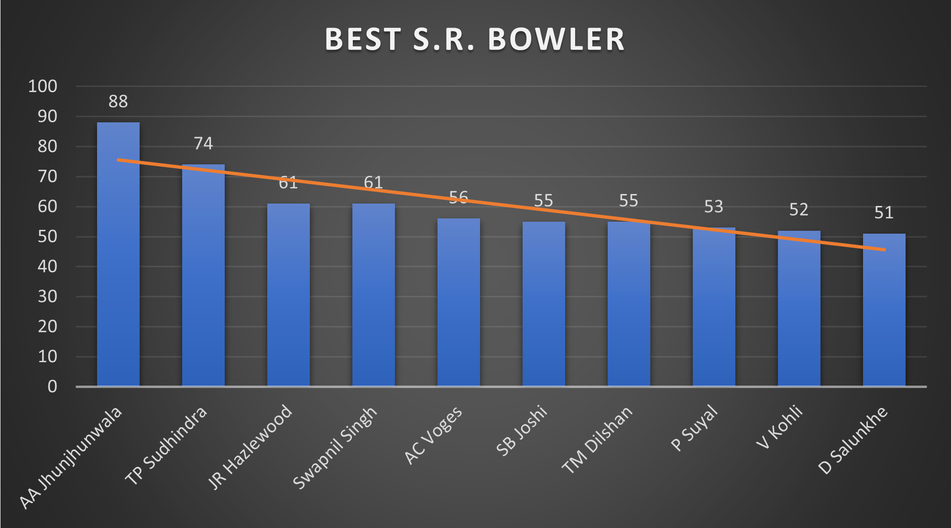

Slide 14
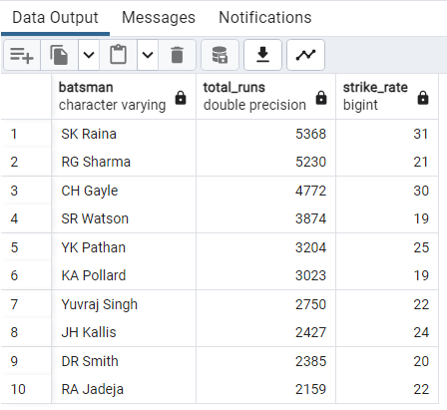
OBJECTIVE VI –
Now you need to get 2-3 All_rounders with the best batting as well as bowling strike rate and who have faced at least 500 balls in IPL so far and have bowled minimum 300 balls.To do that you have to make a list of 10 players you want to bid in the auction.
WITH BatsmanTotalRuns AS (
SELECT batsman,
SUM(batsman_runs) AS total_runs
FROM ipl_ball
GROUP BY batsman
HAVING COUNT(*) > 500),
BowlerStrikeRate AS (
SELECT bowler,
COUNT(*) / NULLIF(SUM(is_wicket), 0) AS strike_rate
FROM ipl_ball
GROUP BY bowler
HAVING COUNT(*) > 300 AND SUM(is_wicket) > 0
)
SELECT
btg.batsman,
btg.total_runs,
bwg.strike_rate
FROM BatsmanTotalRuns btg
JOIN BowlerStrikeRate bwg ON btg.batsman = bwg.bowler
ORDER BY btg.total_runs DESC,
bwg.strike_rate DESC
LIMIT 10;

Slide 15
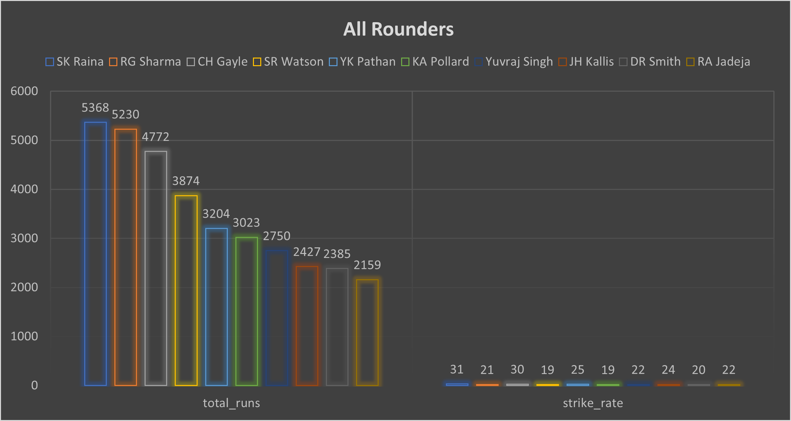

Slide 16
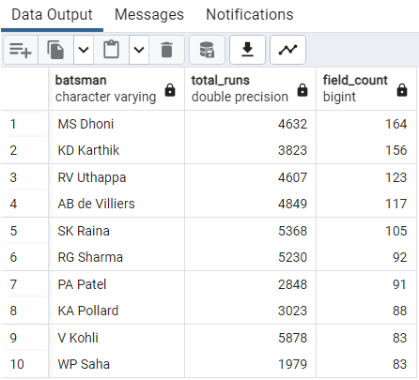
OBJECTIVE VII – Define criteria for wicketkeeper. the wicketkeeper still has an important role, as they are responsible for catching and stumping the batsman. In T20 cricket, where every run and wicket is crucial, a good wicketkeeper can make a big difference to the team's chances of winning.
Criteria - In my opinion, the Wicketkeeper should be a GOOD BATSMEN and should be a GOOD FIELDER as he plays an important role in catching and stumping the batsman
SELECT
bt.batsman,
bt.total_runs,
bw.field_count
FROM (SELECT
batsman,
SUM(batsman_runs) AS total_runs
FROM ipl_ball
GROUP BY batsman
HAVING
COUNT(*) > 500) AS bt
JOIN
(SELECT
fielder,
SUM(is_wicket) AS field_count
FROM ipl_ball
GROUP BY fielder
HAVING
COUNT(*) > 80
AND SUM(is_wicket) > 0) AS bw ON bt.batsman = bw.fielder
ORDER BY
bw.field_count DESC,
bt.total_runs DESC
LIMIT 10;

Slide 17
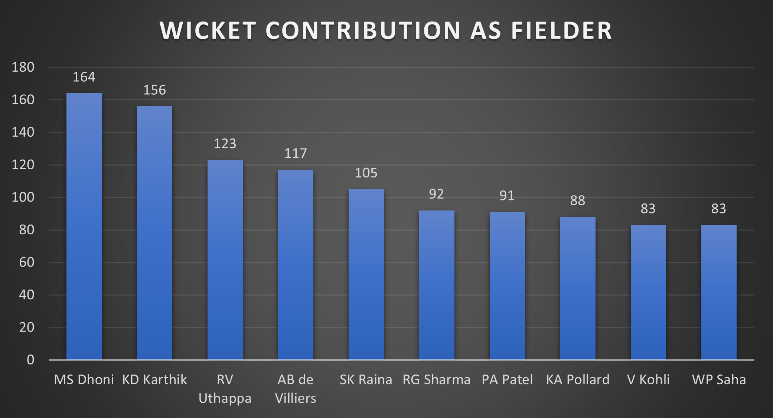

Slide 18
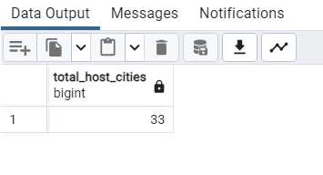
Additional Quests –
1] Get the count of cities that have hosted an IPL match
SELECT COUNT(DISTINCT city) AS Total_host_cities
FROM ipl_matches;

Slide 19
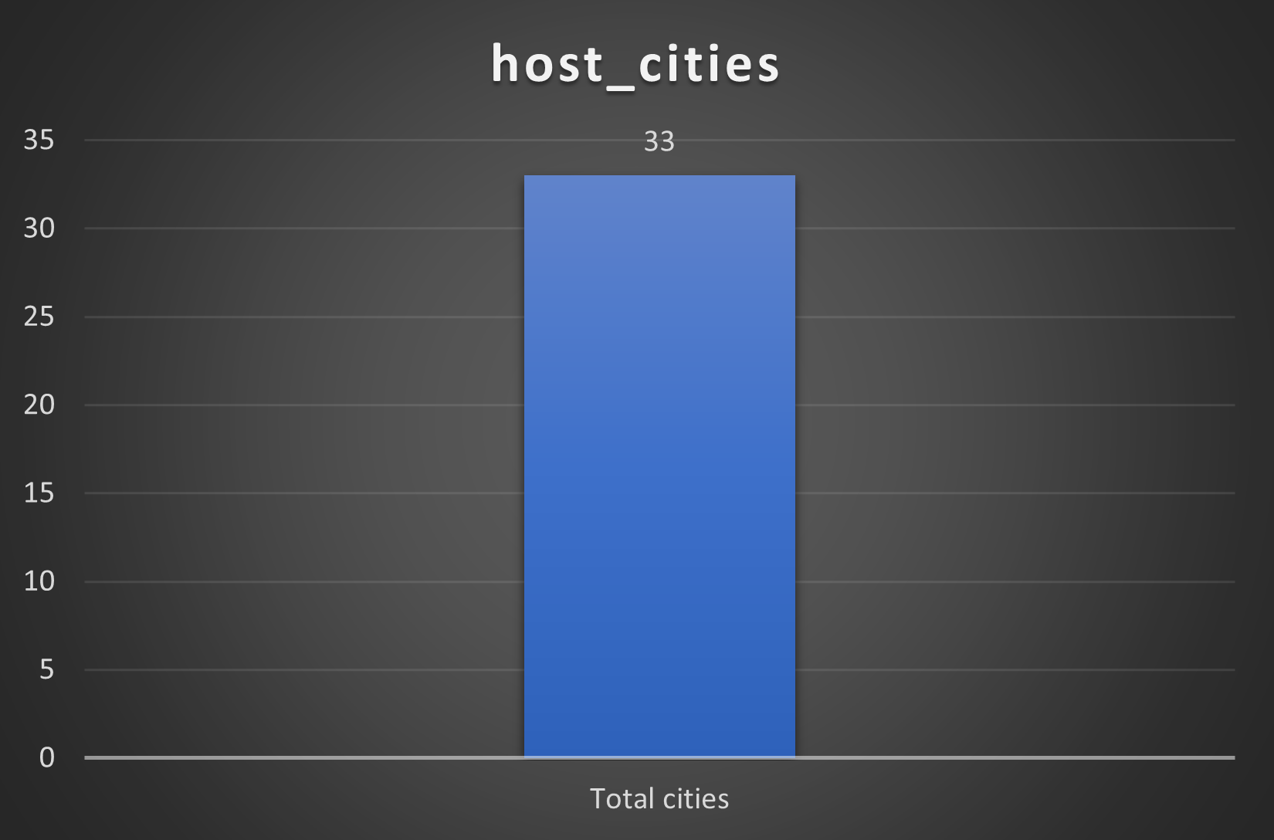

Slide 20
Additional Quests –
2] Create table deliveries_v02 with all the columns of the table ‘deliveries’ and an additional column ball_result containing values boundary, dot or other depending on the total_run (boundary for >= 4, dot for 0 and other for any other number)
SELECT *,
CASE
WHEN total_runs >= 4 THEN 'boundary'
WHEN total_runs = 0 THEN 'dot'
ELSE 'other'
END AS ball_result
FROM ipl_ball;
CREATE TABLE deliveries_v02 AS
SELECT *,
CASE
WHEN total_runs = 0 THEN 'dot'
WHEN total_runs >= 4 THEN 'boundary'
ELSE 'other'
END AS ball_result
FROM ipl_ball;

Slide 21
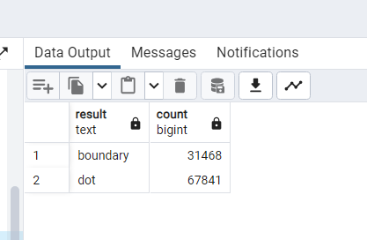
Additional Quests –
3] Write a query to fetch the total number of boundaries and dot balls from the deliveries_v02 table.
SELECT
CASE
WHEN total_runs = 0 THEN 'dot'
WHEN total_runs >= 4 THEN 'boundary'
ELSE 'other'
END AS result,
COUNT(*) AS count
FROM
ipl_ball
WHERE
CASE
WHEN total_runs = 0 THEN 'dot'
WHEN total_runs >= 4 THEN 'boundary'
ELSE 'other'
END IN ('boundary', 'dot')
GROUP BY
result;

Slide 22
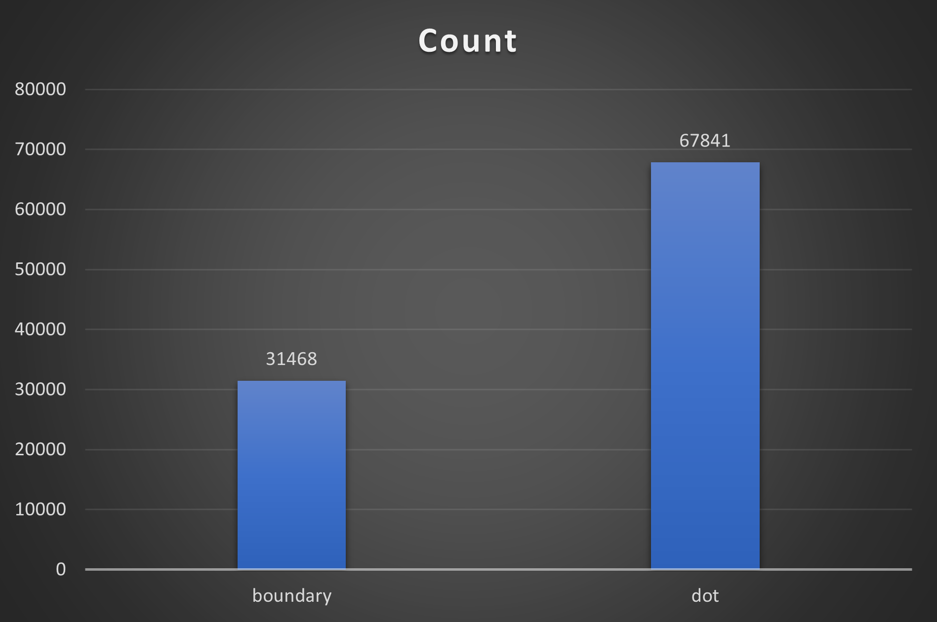

Slide 23
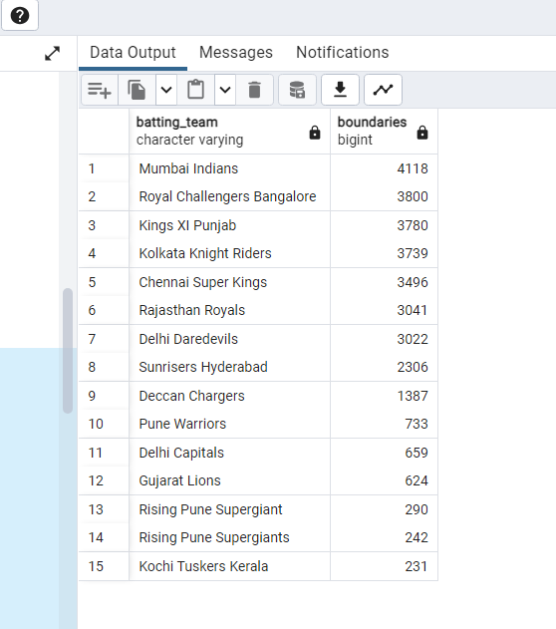
Additional Quests –
4] Write a query to fetch the total number of boundaries scored by each team from the deliveries_v02 table and order it in descending order of the number of boundaries scored.
SELECT
batting_team,
COUNT(*) AS boundaries
FROM
ipl_ball
WHERE
CASE
WHEN total_runs >= 4 THEN 'boundary'
ELSE 'other'
END = 'boundary'
GROUP BY
batting_team
ORDER BY
boundaries DESC;

Slide 24
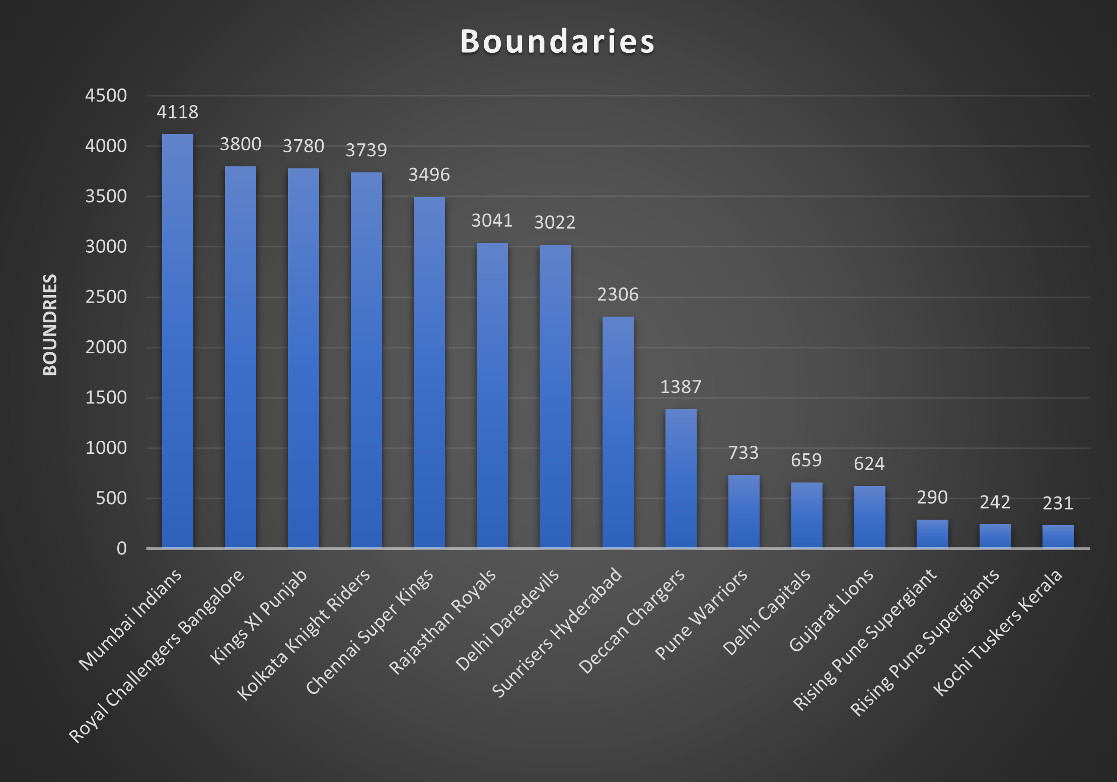

Slide 25
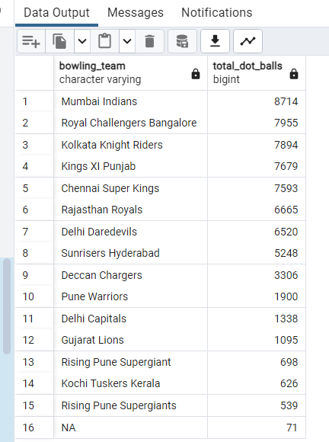
Additional Quests –
5] Write a query to fetch the total number of dot balls bowled by each team and order it in descending order of the total number of dot balls bowled.
SELECT
bowling_team,
COUNT(*) AS total_dot_balls
FROM
ipl_ball
WHERE
CASE
WHEN total_runs = 0 THEN 'dot'
WHEN total_runs >= 4 THEN 'boundary'
ELSE 'other'
END = 'dot'
GROUP BY
bowling_team
ORDER BY
total_dot_balls DESC;

Slide 26
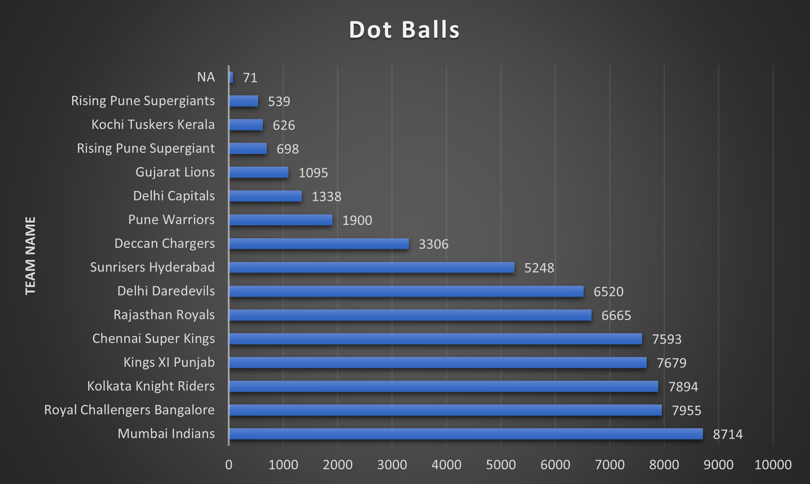

Slide 27
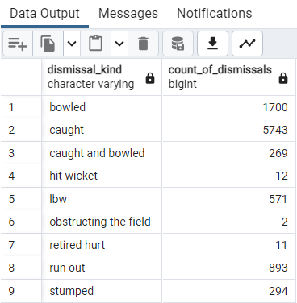
Additional Quests –
6] Write a query to fetch the total number of dismissals by dismissal kinds where dismissal kind is not NA
SELECT
dismissal_kind,
COUNT(*) AS count_of_dismissals
FROM
ipl_ball
WHERE
dismissal_kind IS NOT NULL
AND dismissal_kind <> 'NA'
GROUP BY
dismissal_kind;

Slide 28
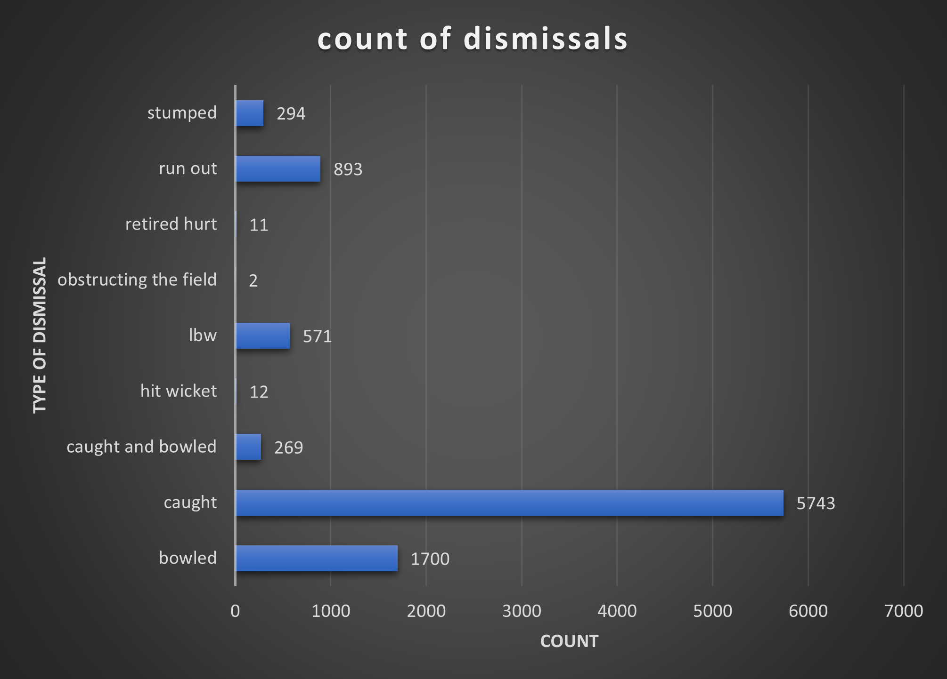

Slide 29
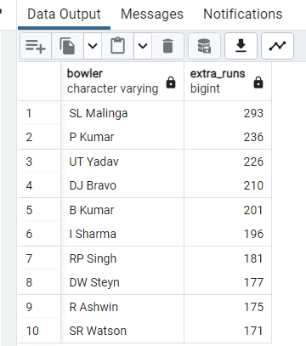
Additional Quests –
7] Write a query to get the top 5 bowlers who conceded maximum extra runs from the deliveries table
SELECT
bowler,
SUM(extra_runs) AS extra_runs
FROM
ipl_ball
GROUP BY
bowler
ORDER BY
extra_runs DESC
LIMIT 10;

Slide 30
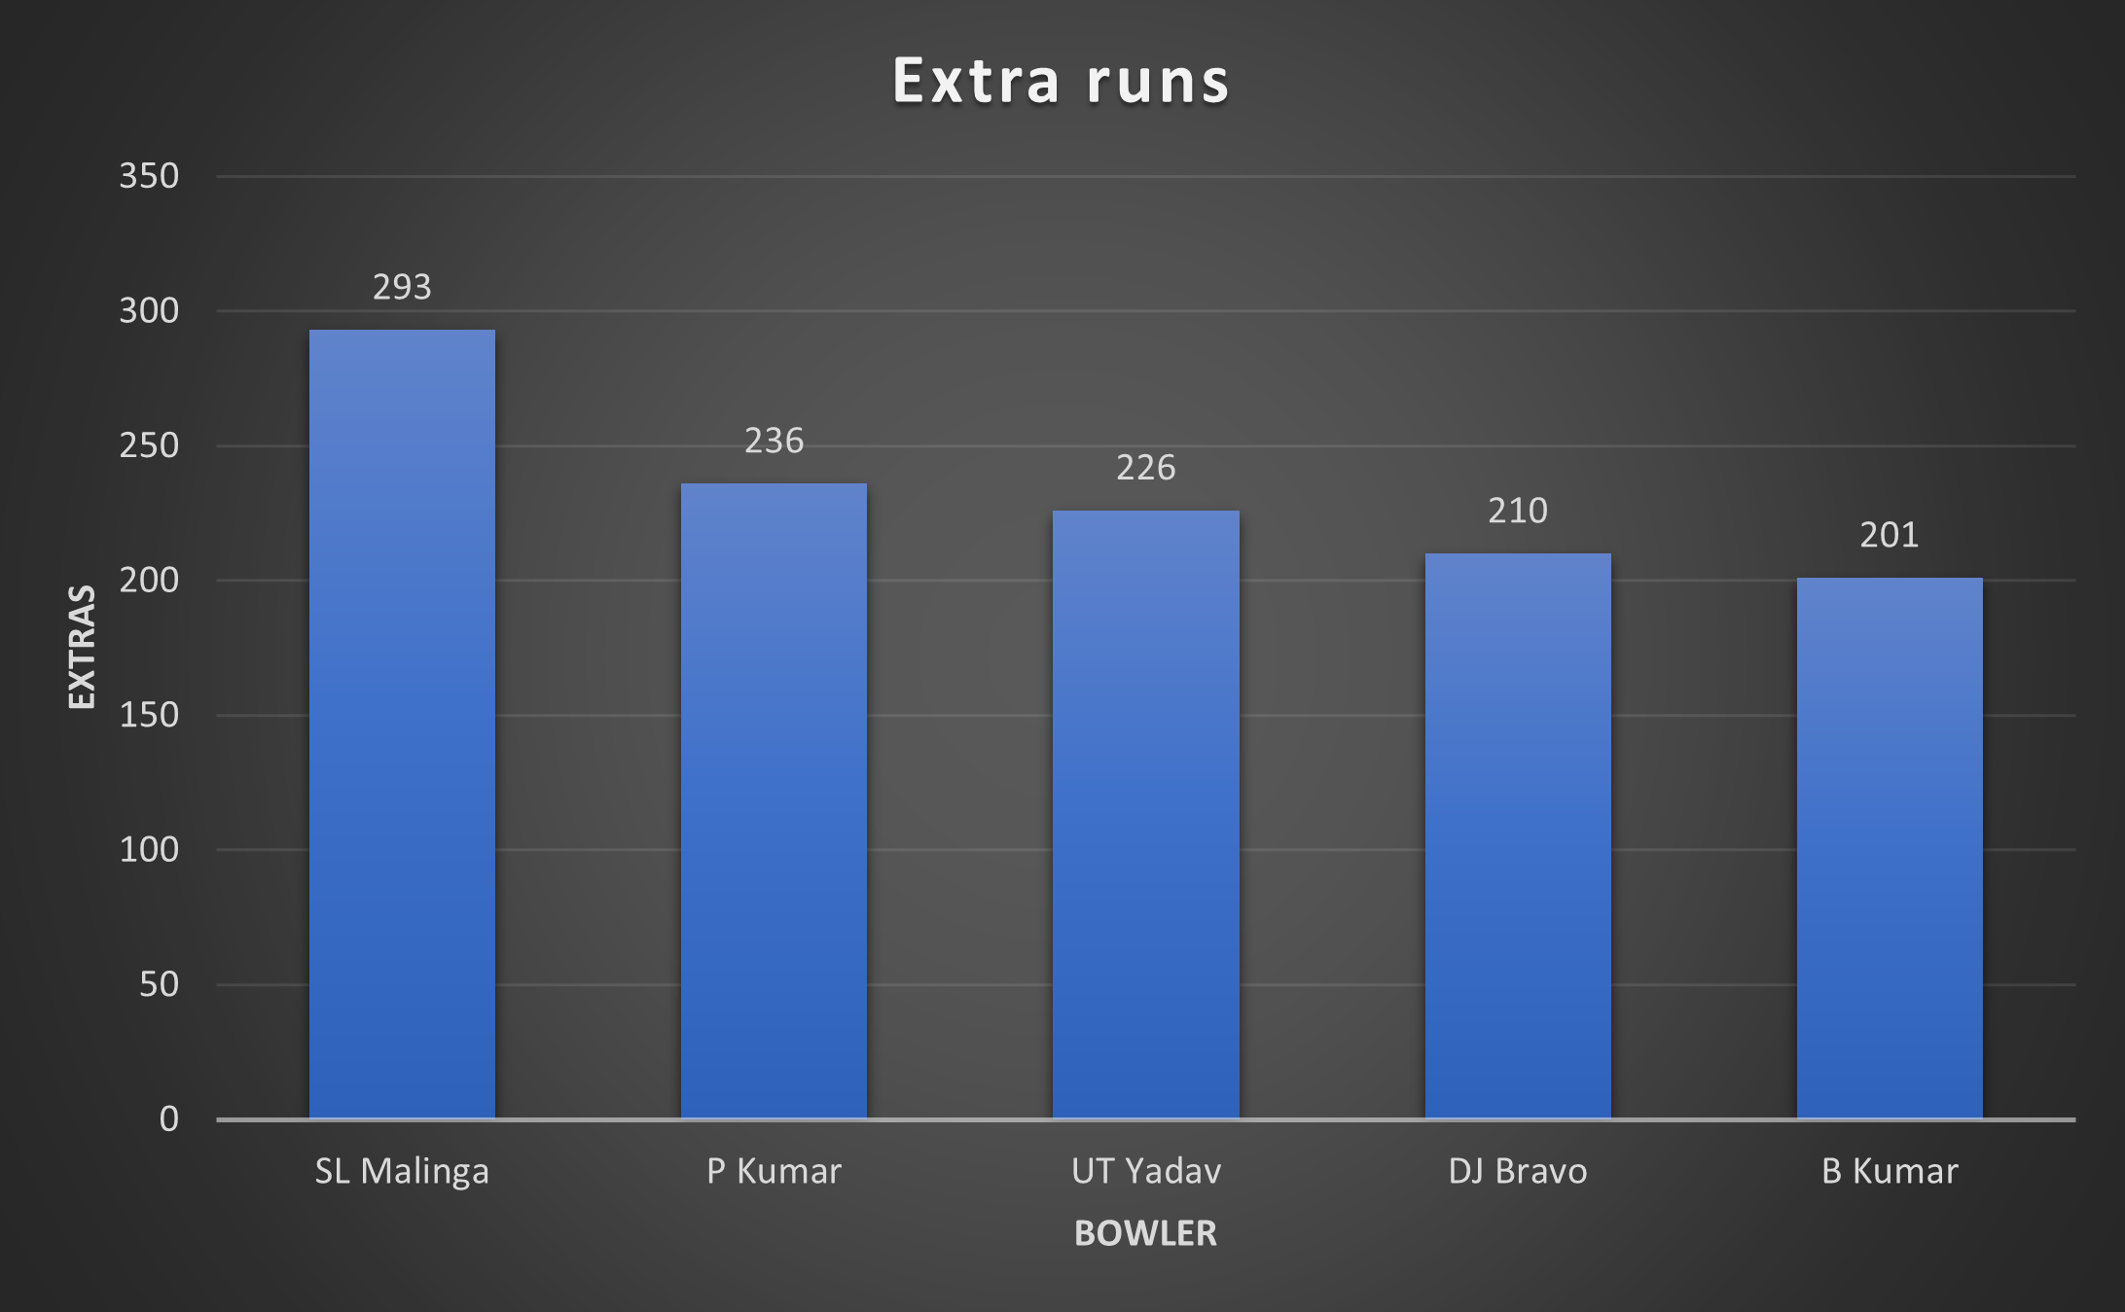

Slide 31
Additional Quests –
8] Write a query to create a table named deliveries_v03 with all the columns of the deliveries_v02 table and two additional columns (named venue and match_date) of venue and date from table matches
CREATE TABLE deliveries_v03 AS
SELECT
dv02.*,
m.venue,
m.date AS match_date
FROM
ipl_ball dv02
INNER JOIN
ipl_matches m ON dv02.id = m.id;
select * from deliveries_v03

Slide 32
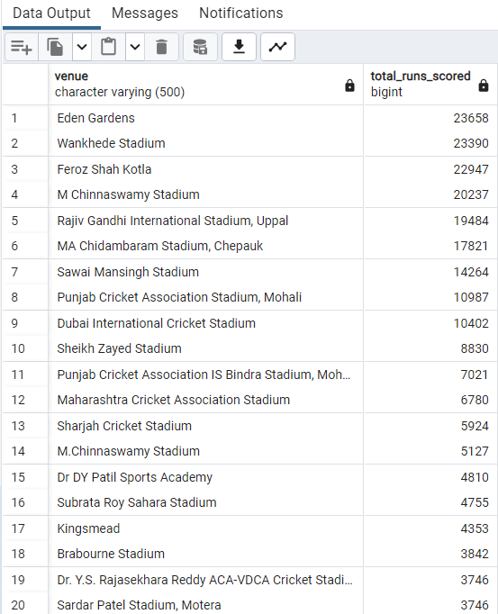
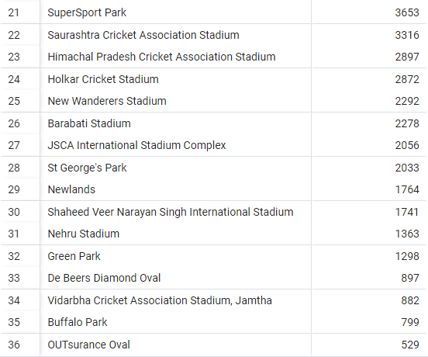
Additional Quests –
9] Write a query to fetch the total runs scored for each venue and order it in the descending order of total runs scored.
SELECT venue,
SUM(total_runs) AS total_runs_scored
FROM
deliveries_v03
GROUP BY
venue
ORDER BY
total_runs_scored DESC;

Slide 33
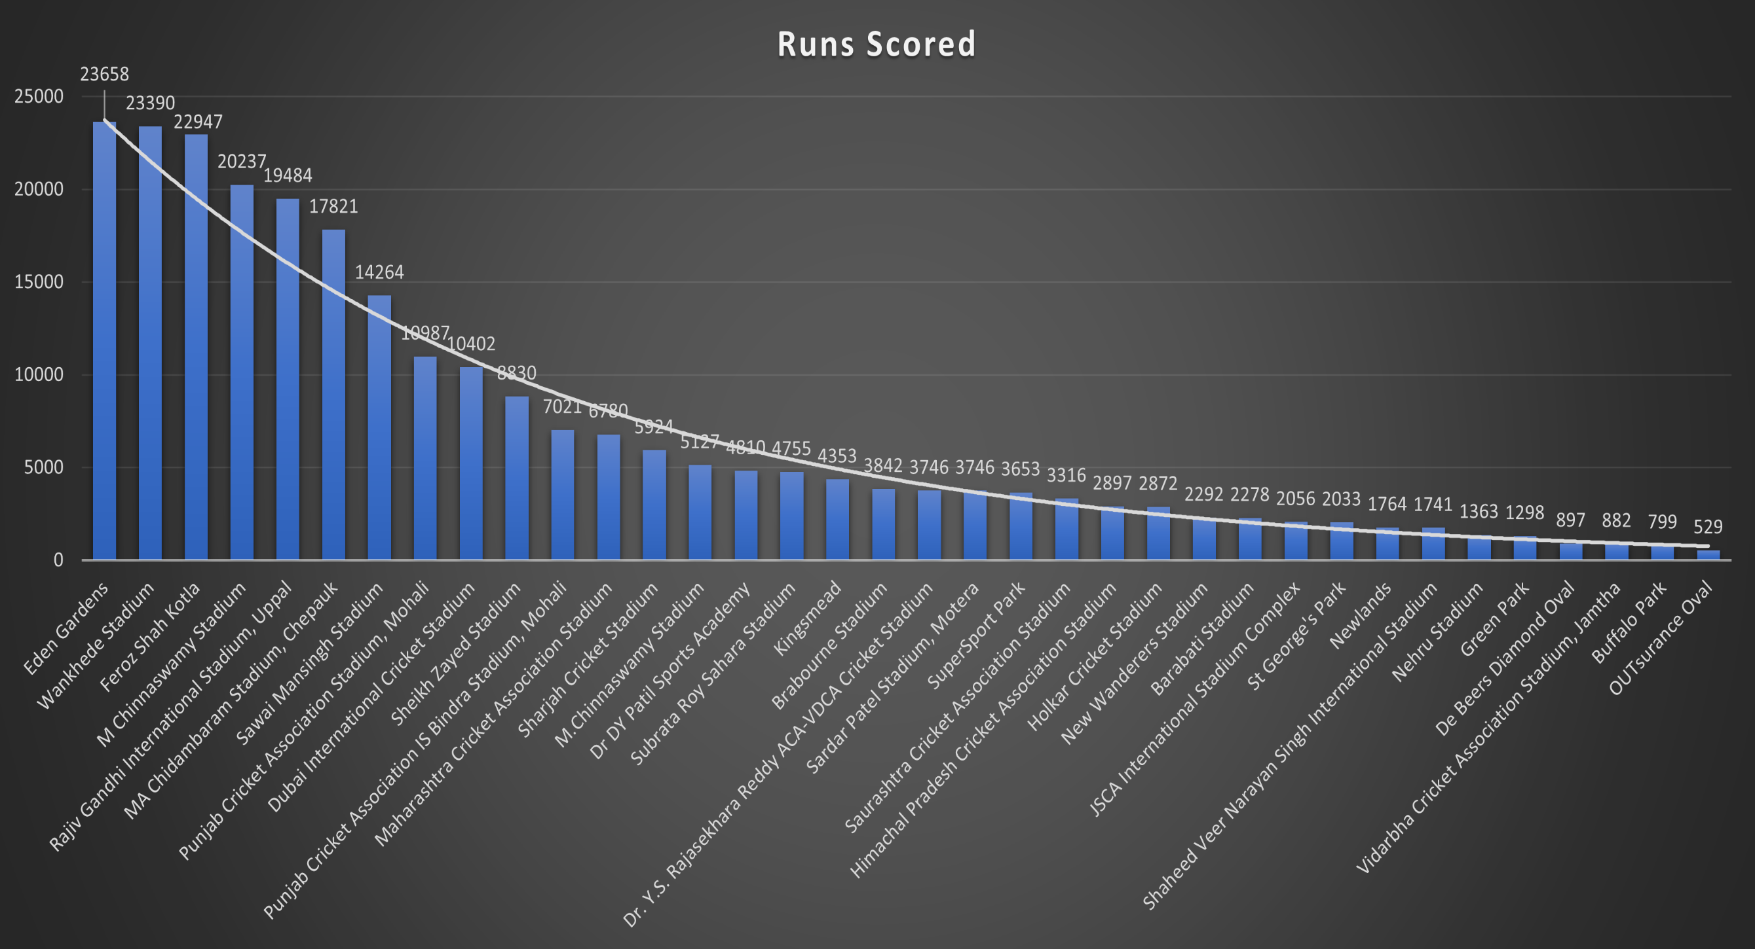

Slide 34
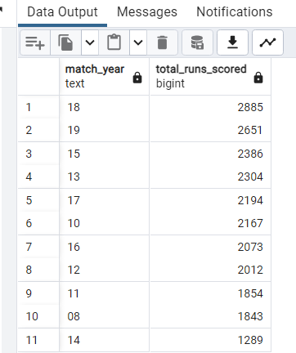
Additional Quests –
10] Write a query to fetch the year-wise total runs scored at Eden Gardens and order it in the descending order of total runs scored.
SELECT
Substring (match_date, 7,8) as match_year,
SUM(total_runs) AS total_runs
FROM
deliveries_v03
WHERE
venue = 'Eden Gardens'
GROUP BY
match_year
ORDER BY
total_runs DESC;

Slide 35
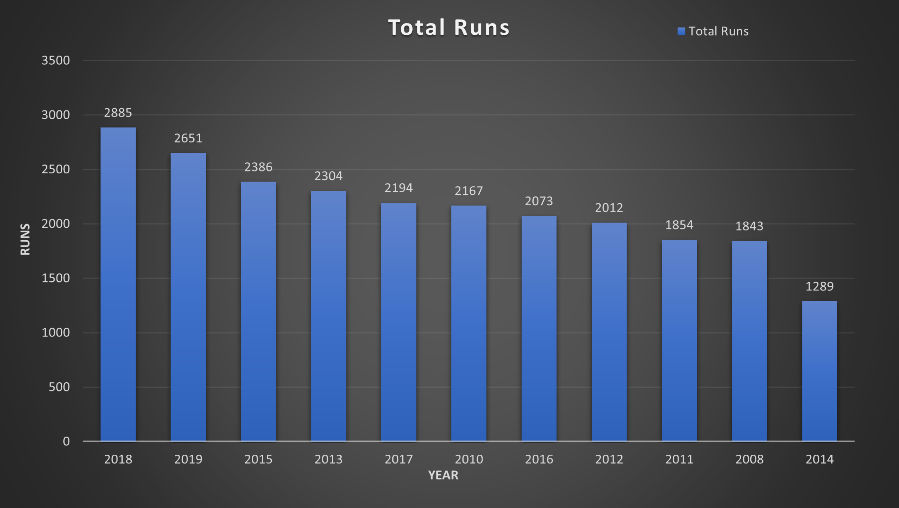

Slide 36




Thank
you

